Slide 1



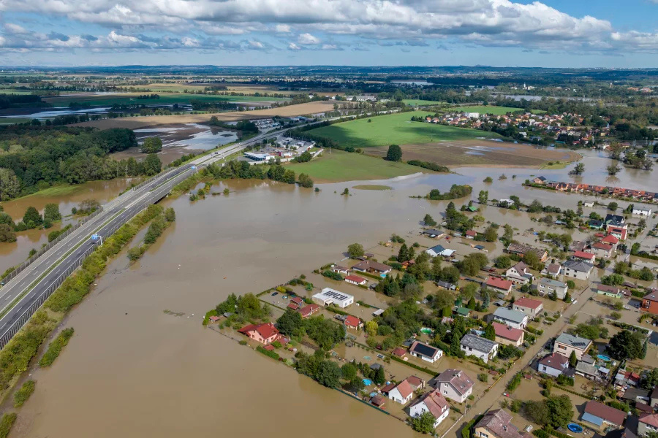
Bangladesh Studies (BNS101)
ADDRESSING THE FLOOD PROBLEM
IN BANGLADESH
A Look at Causes and Solutions

Slide 2




Our Team
Sanzida Akter Nupur
ID: 232-15-759
Md Shahinur Kabir Antor
ID: 232-15-159
Pallab Debnath
ID: 232-15-676
Supan Roy
ID: 232-15-716
Umme Arifa Zaman Nirjhor
ID: 232-15-695

Slide 3

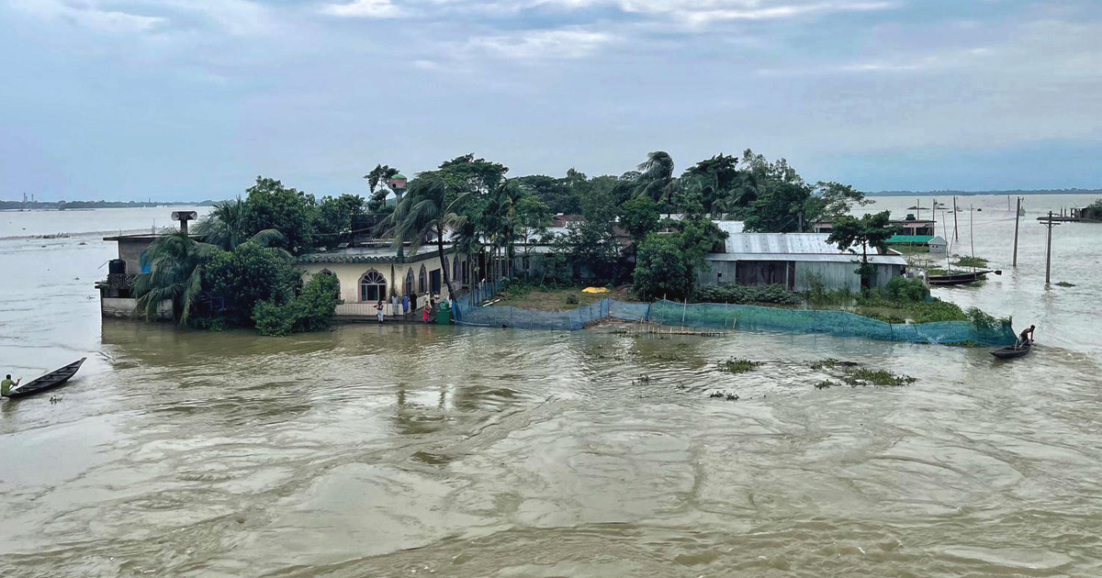

Area Covered
Introduction
Causes of Flood
Types and Impacts of Floods
Flood Risk Management
Technological Solutions
Sustainable Solutions and Conclusion

Slide 4

Introduction
Floods are a common and devastating natural disaster in Bangladesh, occurring almost every year. Due to its geographical location, Bangladesh lies in a flood-prone region, surrounded by major river systems like the Ganges, Brahmaputra, and Meghna. These rivers, combined with the effects of heavy monsoon rainfall and rising sea levels, make the country highly vulnerable to floods.
In this presentation, we will explore the causes, types, and impacts of floods in Bangladesh. We will also discuss risk management strategies, technological advancements, and sustainable solutions that can help mitigate the flood problem for a safer future.

Slide 5

Causes of Flood
The causes of floods in Bangladesh are influenced by a combination of natural and
human-induced factors:
Heavy Monsoon Rainfall: Bangladesh experiences extremely high levels of rainfall during the monsoon season (June to October).
Geography and River Systems: Many rivers flow into Bangladesh from neighboring India. In 2024, rivers like the Gomti and the Feni, originating in India's Tripura, overflowed due to intense rainfall and inadequate drainage infrastructure.
Dam Releases from India: The Dumboor Dam in India’s Tripura state played a role in worsening the situation.
Tidal Surges and High Tides: In addition to rainfall, high tides during the full moon contributed to raising water levels, especially in coastal areas. This natural occurrence worsened the floods​.
Climate Change: Long-term climate changes have led to more erratic weather patterns, including heavier rains and more frequent flooding, intensifying the problem.

Slide 6
Types of Floods in Bangladesh
Major types of floods occur in Bangladesh are:
Riverine Floods: Occur when rivers overflow due to excessive rainfall, especially near the Ganges, Brahmaputra, and Meghna rivers.
Flash Floods: Sudden floods in hilly areas, caused by intense rains over a short time, common in northeastern regions like Sylhet.
Urban Flooding: Happens in cities with poor drainage systems, such as Dhaka, due to heavy rainfall and waterlogging.
Coastal Flooding: Triggered by cyclones or tidal surges, affecting coastal areas like Khulna and Barisal.

Slide 7
Impacts of Floods
The causes of floods in Bangladesh are influenced by a combination of natural and
human-induced factors:
Human Impact: Floods cause casualties, displacement, and waterborne diseases. The 2024 floods affected over 5.7 million people.
Economic Impact: Destruction of crops and damage to infrastructure disrupts livelihoods and economic stability.
Environmental Impact: Soil erosion, riverbank collapses, and loss of ecosystems occur, affecting both agriculture and biodiversity.

Slide 8

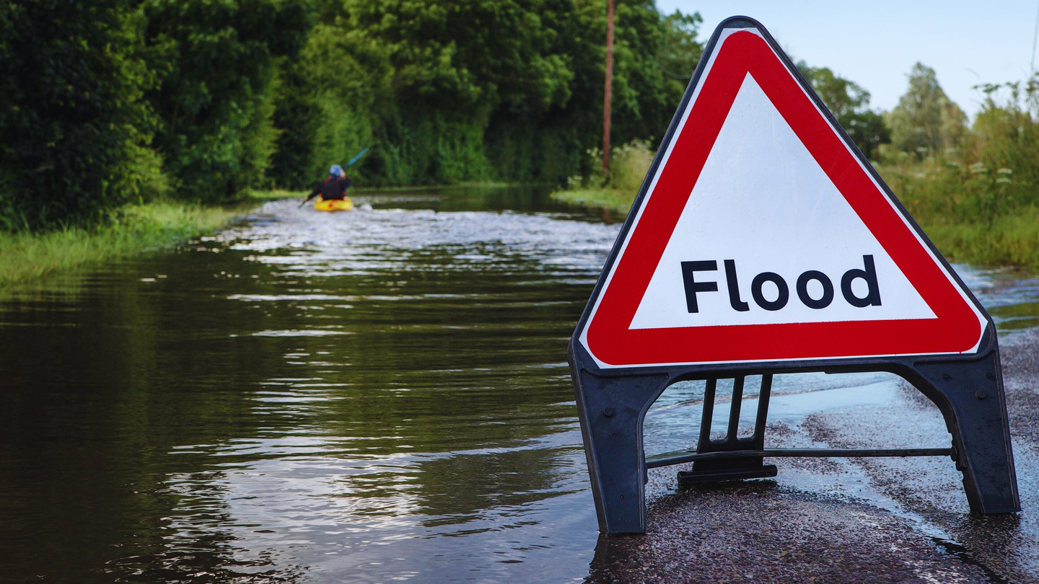

Flood Risk Management

Slide 9
Flood Risk Management
Early Warning Systems: Bangladesh has developed early warning systems to alert communities about impending floods. These systems use real-time data from meteorological stations and river monitoring to predict floods, allowing residents to evacuate in time.
Flood Forecasting and Monitoring: Collaboration with neighboring countries like India helps Bangladesh monitor water levels of rivers that flow across borders. This forecasting helps prepare for floods by estimating when and where they will occur

Slide 10
Flood Risk Management
River Management: Dredging and embankments are used to manage river water flow and prevent overflow during heavy rainfall. Riverbank reinforcement also helps reduce the risk of erosion and collapse.
Community-based Adaptation: Local communities are trained to respond quickly to flood warnings, use flood shelters, and implement measures like raising homesteads and securing livestock.
Infrastructure Development: Building flood-resilient infrastructure, such as elevated roads, bridges, and homes, helps minimize damage. Additionally, constructing flood retention areas and drainage systems helps manage water flow in urban regions.

Slide 11
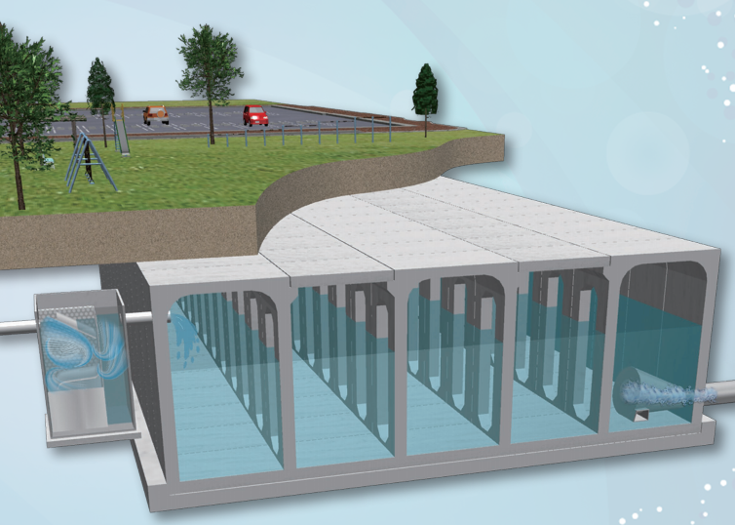
Technological Solutions

Slide 12
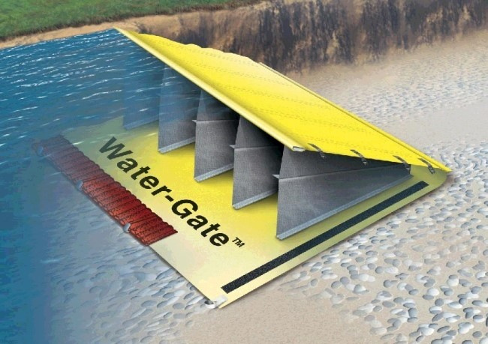
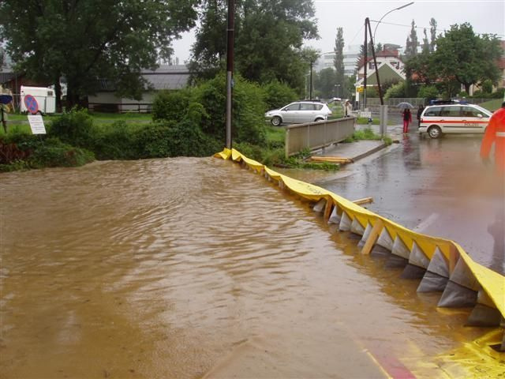
Technological Preventions for Flood Management
1) Water Gate: Rapid Response Flood Control System
Water Gate is a clever PVC device that uses the pressure of oncoming water to stabilize itself. While more expensive than sandbags, it has been proven to be a highly effective means of containing flood damage. A single person can deploy the product in a few hours to protect a home, or larger devices can be purchased to protect entire areas and unrolled trucks.
The product is lighter than sandbags, reusable and doesn’t require filler material that will be contaminated after use.

Slide 13
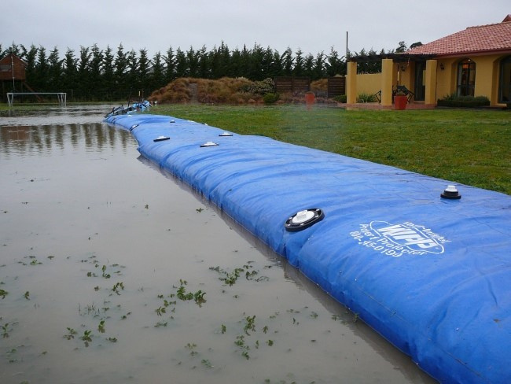
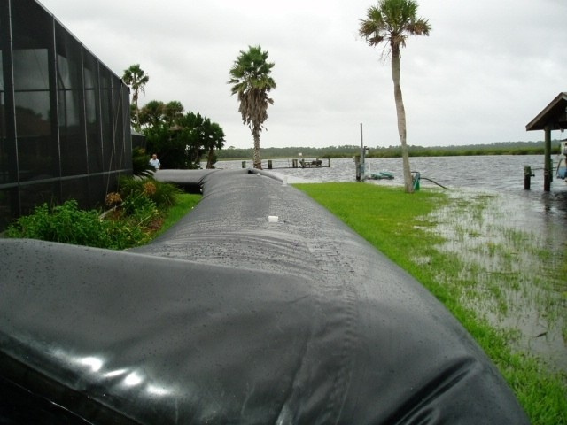
Technological Preventions for Flood Management
2) WIPP: Water Inflated Property Protector
The “Water Inflated Property Barrier” (WIPP) made from a long (up to 150 ft.), extremely durable, vinyl-coated polyester. The idea is to fight water with water, and WIPP does just that; essentially a long tube with an internal support structure, the system can be inflated with any nearby water source, acting as a heavy barrier against oncoming waters.
Like other systems, WIPP can be easily and quickly deployed, repaired and packed away compactly when not in use.

Slide 14
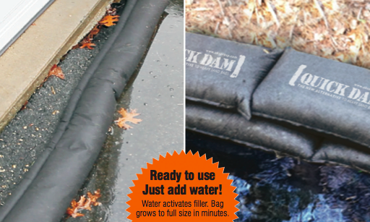
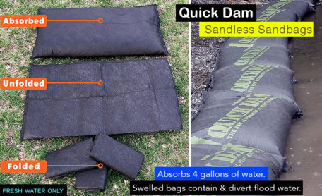
Technological Preventions for Flood Management
3) Quick Dam: Flood Barrier Socks
Quick Dams – water barrier socks are the fastest growing flood protection device in North America. Over the past year Quick Dam’s distribution has grown to include all major home renovation retailers (ie. Home Depot, Lowes, Rona) as well as a large Amazon store stocked with product variations.
The Quick Dam flood barriers are available in 5ft, 10ft and 17ft long pieces, suitable for all types of environments. And based on reviews so far, the product is doing a good job of keep homeowners property dry in the wake of rising flood waters.

Slide 15
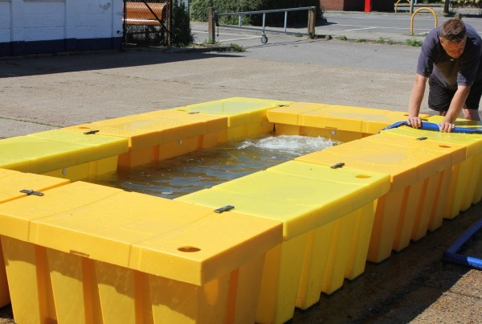
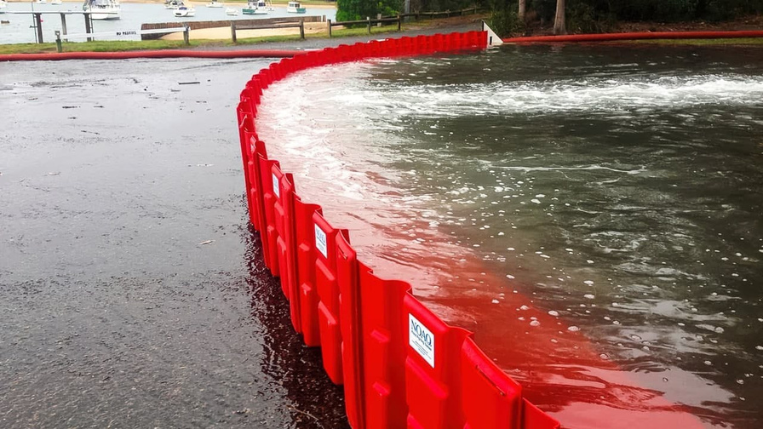
Technological Preventions for Flood Management
4) Floodblock: Modular Flood Prevention Solution
FloodBlock is another Lego-like invention that can be interlocked, stacked and positioned to protect homes and commercial spaces from flooding. The device is a self-filling crate with foam padding on the bottom creating a seal which prevents water seeping from underneath. The stacking feature ensures a minimal footprint when stored away. The simplicity of the system and its light weight means that no special training is required to assemble – and it’s a high quality, affordable solution that’s more effective than sandbags.

Slide 16
Technological Solutions for Flood Management
Satellite-Based Monitoring: Bangladesh uses satellites to track rainfall and river levels, providing real-time data for better flood prediction and early warnings.
GIS and Remote Sensing: Geographic Information Systems (GIS) analyze terrain and water flow to map flood risks, improving disaster preparedness and resource allocation.
Flood Forecasting Models: Advanced models predict flood intensity and duration using river and rainfall data, enabling timely evacuations and emergency response.
Smart Warning Systems: Automated systems send flood alerts via SMS and apps to quickly inform residents in flood-prone areas, ensuring safety.
Drones for Damage Assessment: Drones assess flood damage in hard-to-reach areas post-flood, aiding in effective recovery planning.

Slide 17
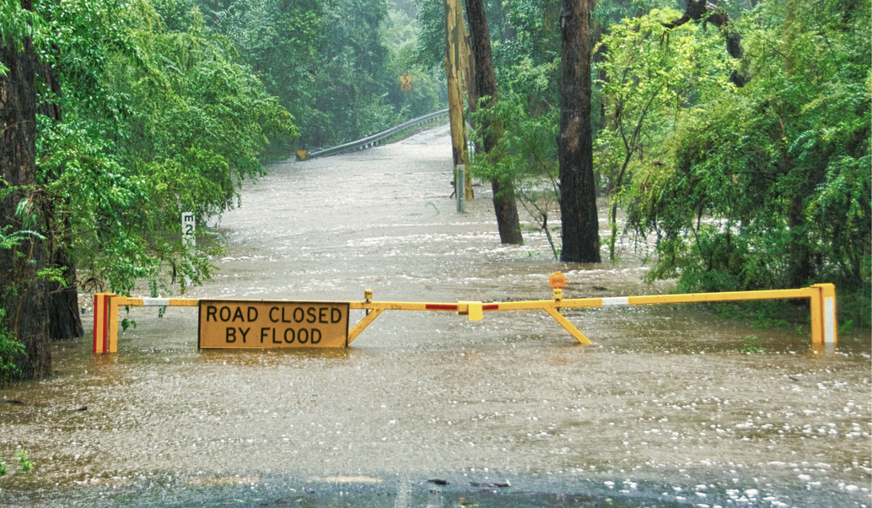
Sustainable Solutions

Slide 18
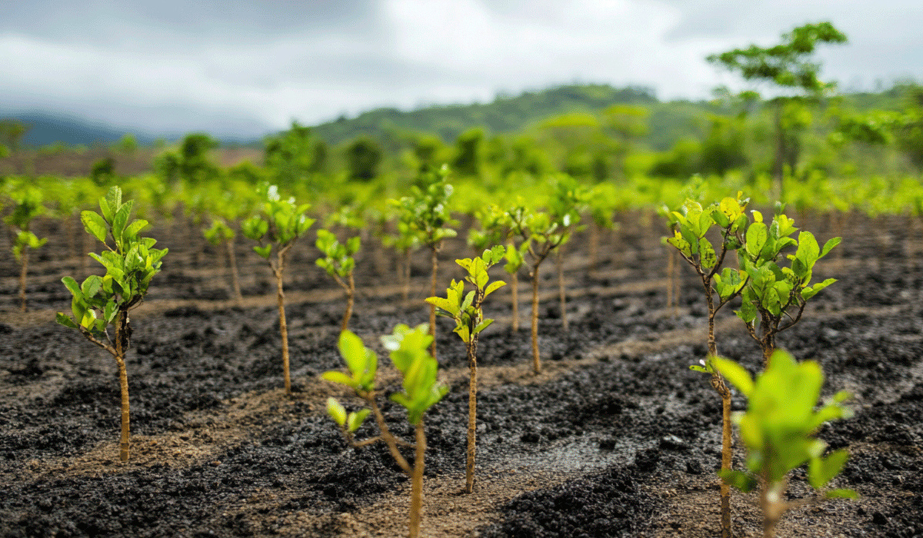
Sustainable Solutions for Flood Management
Reforestation and Wetland Conservation:
Planting trees and restoring wetlands help absorb floodwaters and reduce runoff. Forests near rivers act as natural buffers, slowing down water flow and reducing soil erosion. Expanding these green zones can significantly mitigate the impact of floods.
2. Eco-friendly Urban Planning:
Cities in Bangladesh, like Dhaka, should implement Sustainable Urban Drainage Systems. These systems focus on absorbing rainwater into the ground through green roofs, permeable pavements, and constructed wetlands, which help prevent urban waterlogging during heavy rains.
3. Building Flood-Resilient Infrastructure:
Constructing elevated homes, roads, and flood shelters in flood-prone areas ensures that communities are better protected. Riverbank stabilization using eco-friendly materials and reinforcing embankments help reduce the risk of overflow during monsoon seasons.

Slide 19
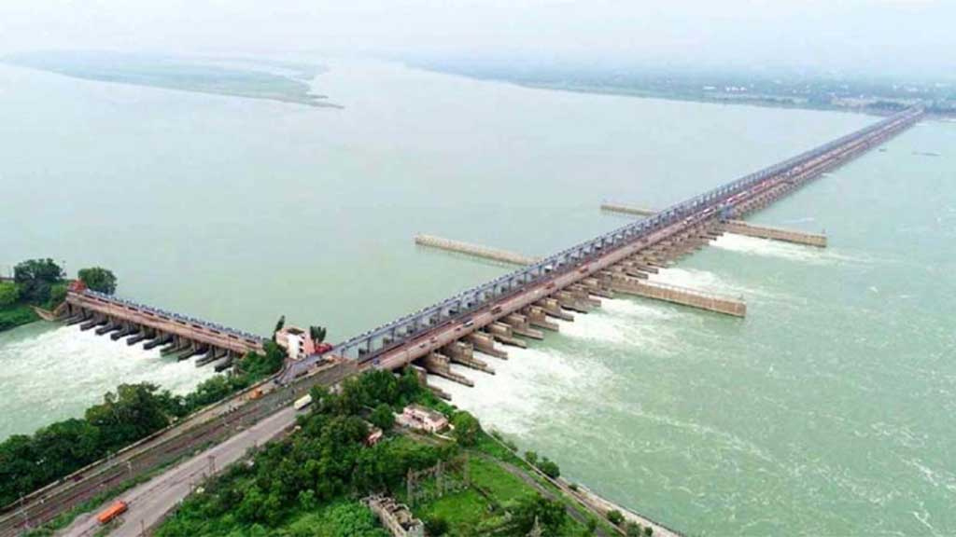
Sustainable Solutions for Flood Management
4. Cooperation on River Water Management:
Coordinated management of cross-border rivers, especially with India, is crucial. Many of Bangladesh’s major rivers, like the Ganges and Brahmaputra, originate in India. Uncontrolled water release from Indian dams, like the Farakka Barrage, can worsen flooding in downstream areas of Bangladesh. Sustainable, fair water-sharing agreements and joint flood management plans between the two countries are essential to reducing flood risks.
5. Community-Based Adaptation:
Training local communities in flood preparedness, sustainable agriculture (like flood-tolerant crops), and using flood-resistant construction techniques can improve long-term resilience. Locally-driven solutions also ensure that the unique needs of each region are addressed effectively.

Slide 20


Conclusion
Floods remain a significant challenge in Bangladesh, but a combination of modern technology, sustainable practices, and community involvement can help mitigate their impacts. By focusing on early warning systems, better infrastructure, and international cooperation, Bangladesh can build a more flood-resilient future. Sustainable solutions like reforestation, improved drainage, and smart water management will help reduce the frequency and damage of floods, safeguarding both people and the environment.

Slide 21


THANK YOU!
Team Baishpholok

